Slide 1

MTECH AAI COHORT-1 Dissertation Project – Phase II
Evaluation-I
Presented by: Sanjeev Kumar Pandey
Enrolment No: MT23AAI001
Project Guide: Dr. Amit Agrawal

Slide 2
Human ID & Activity Prediction using Wi-Fi Signals
Leveraging Wi-Fi Channel State Information (CSI) and RSSI
Sanjeev Kumar Pandey | 10-Sep-2025

Slide 3
Project Objectives
Dataset Aim: Wi-Fi-based Human Activity Recognition (HAR) in indoor environments (LOS & NLOS).
Objective 1: Detect the activity action type from Wi-Fi signals.
Objective 2: Detect the ID of the person performing the activity.

Slide 4
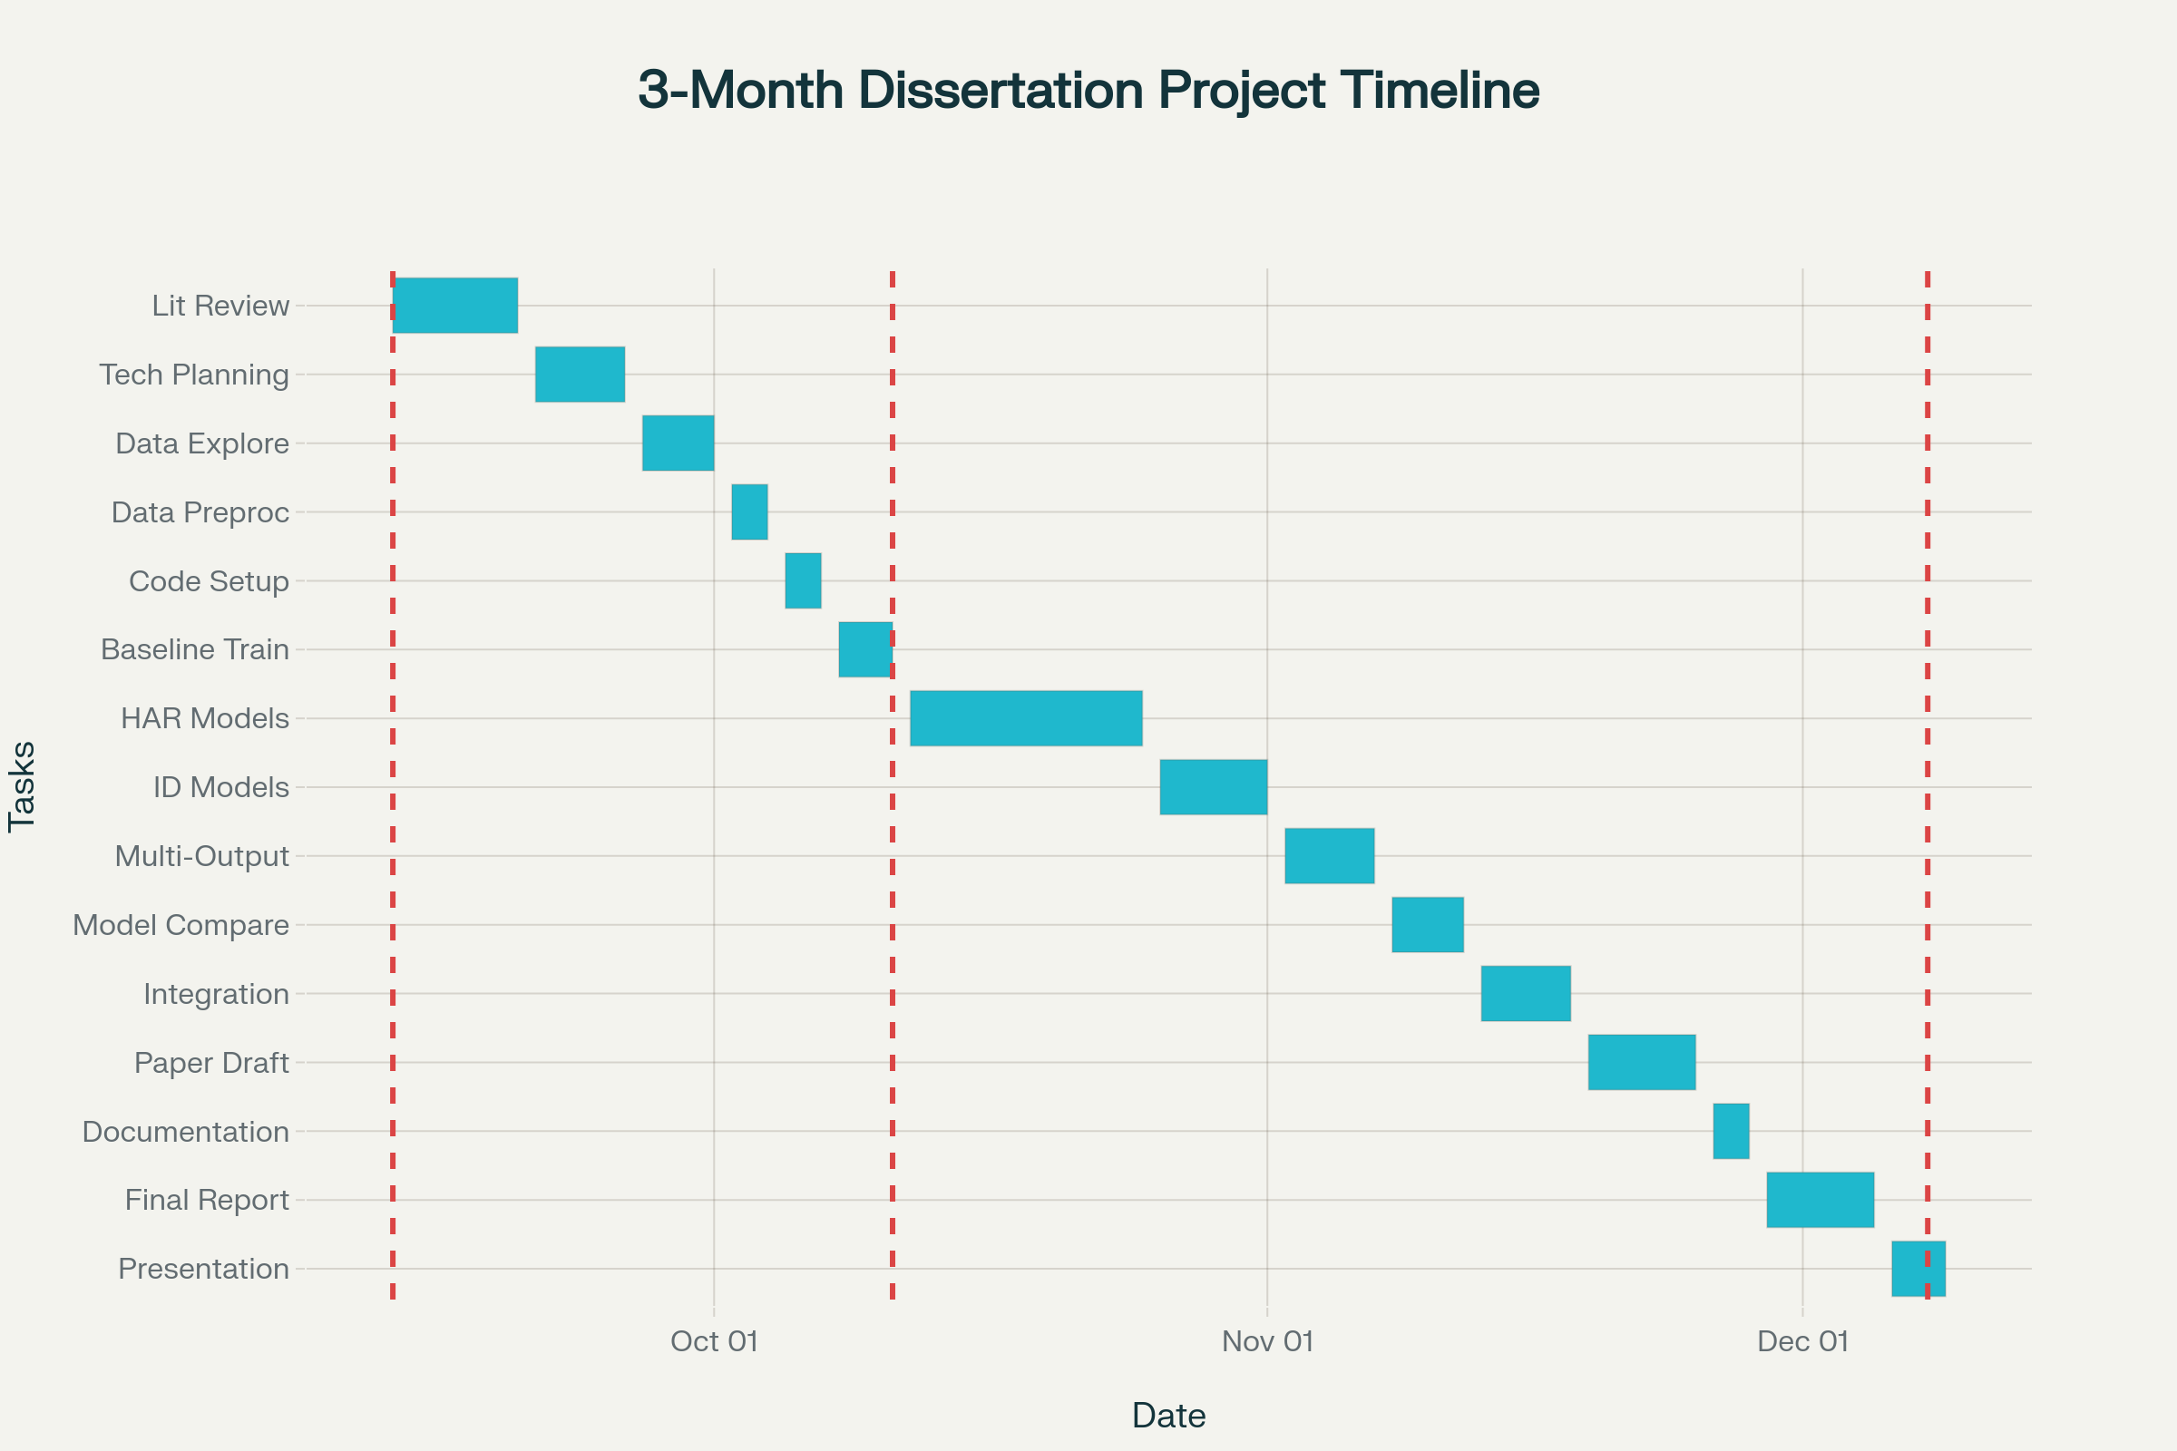

Slide 5
Planning overview
Literature Review & Planning: Start with reading key papers, setting objectives, and technical planning.
Data Understanding & Preprocessing: Explore dataset, feature extraction, and handle CSI/RSSI preprocessing.
Initial Coding & Baseline Model (Eval 1): Set up coding, implement baseline models, run initial training and evaluation.
Advanced Model Training & Experimentation (Eval 2): Design and train advanced models (HAR, Human ID, multi-output), experiment, and tune.
Analysis & Integration: Compare results, integrate best-performing models, and conduct error analysis.
Research Paper Drafting & Documentation: Start documentation and research paper draft, plus slides for presentation.
Final Report & Presentation (Eval 3): Polish final report, prepare for oral defense, and respond to committee feedback.

Slide 6
Dataset Overview
Source Paper: 'A dataset for Wi-Fi-based human activity recognition in LOS and NLOS indoor environments'. https://pmc.ncbi.nlm.nih.gov/articles/PMC7704290/pdf/main.pdf
Authors: Baha’ A Alsaify et al., Jordan University of Science and Technology, German Jordanian University.
Publication Date: November 18, 2020.
Purpose: Benchmark dataset for HAR research across LOS & NLOS settings.

Slide 7
Key Features of Dataset
Participants: 30 subjects (28 male, 2 female), age ~22.7 ± 2.95 years.
Activities: 12 unique actions across 5 experiment classes.
Environments: 2 LOS (lab, hallway) + 1 NLOS (wooden wall barrier).
Data Types: Channel State Information (CSI) and RSSI values.
File Naming: Ex_Sy_Cz_Ai_Tk.csv (e.g., E1_S04_C3_A7_T17.csv).

Slide 8
Feasibility of Human ID Prediction
Subject ID explicitly labeled in filenames (S1–S30).
Biometric info (age, weight, height) subtly affects signals.
CSI & RSSI are sensitive to individual movement signatures.
Rich dataset (3000 trials) suitable for Human ID modeling.

Slide 9
Use Case: Security & Monitoring
Traditional biometrics (faces, fingerprints) can be spoofed & require active participation.
Wi-Fi-based ID is passive, non-intrusive, and works in NLOS environments.
Applications: High-security zones (ISRO, NASA, Parliament House), covert surveillance, medical alerts.

Slide 10
Target Variables
HAR Activity Recognition: Classify 12 unique activities (A1–A12).
Human ID: Identify 1 of 30 subjects (S1–S30).
Input Data: CSI & RSSI values sensitive to presence & movement.

Slide 11
Model Development Approaches
Approach 1: Two Separate Models
HAR Activity Classifier (12 classes).
Human ID Classifier (30 subjects).
Approach 2: One Multi-Output Model
Single model with shared features.
Two output heads: Activity & ID.

Slide 12
Conclusion & Next Steps
Dataset provides rich labeled Wi-Fi signal data (CSI, RSSI).
Suitable for both HAR and Human ID tasks.
Choice: Separate models (simplicity) vs. Multi-output model (efficiency).
Next Step: Implement and evaluate both approaches.

Slide 13
Loss function is set as cross entropy, suitable for multi-class classification.
Adam optimizer for efficient adaptive gradient-based optimization.
optimizer.zero_grad()
outputs = model(csi_seq, meta_seq)
loss = criterion(outputs, labels)
loss.backward()
optimizer.step()
Zero previous gradients to avoid accumulation.
Forward pass to get outputs.
Compute cross-entropy loss.
Backpropagate loss gradients.
Step optimizer to update weights.

